Slide 1


Introduction to the Labour Force Survey and Annual Population Survey
Copyright © year Institution. Created by Organisation, UK Data Service.
Notes:
Sorch

Slide 2
Can you hear us?​
Use the chat to say where you are.
If you can't hear us...​
Check your speaker/headset is plugged in / volume is on
Leave and reconnect
Try browser or app
Notes:
​Hopefully, you are all hearing me ok. But to test it out, please drop into the chat where you are coming from today – either your city or town or your organisation – whichever you’d like to share. It’s always good to get an idea of who is here today.
We’re in Microsoft teams today, If you’re looking for the chat - The control panel consists of a number of icons and it can be found either at the top or bottom depending on how you’ve joined. Look for the speech bubble to show and hide chat.
Look at the chat to see where people are…..

Slide 3
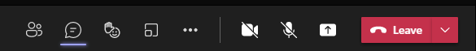
Microsoft teams
Show/hide participants
Applause and other reactions
Show/hide Chat
Notes:
So yes, we’re in Microsoft teams today.
If you haven't found the chat - The control panel consists of a number of icons and it can be found either at the top or bottom depending on how you’ve joined. Look for the speech bubble to show and hide chat.
The people icon next to the chat, will let you the list of participants. If you look under the person with their hand up you have some options to react – such as applauding and sending other emojis. You can put your hand up to get attention.
You can leave and rejoin at any point using the same link.

Slide 4
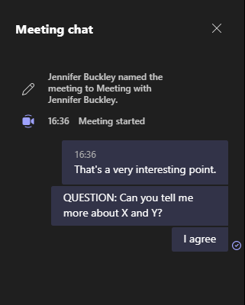
Questions and discussions
Use the chat box to type your questions​
Raise hand
Notes:
Feel free to ask questions. You use the chat box to type questions. Typically, we will come to them at the end of each presentation.

Slide 5
Captions

Slide 6
Accessing LFS and APS data via the UK Data Service
Introduction to the Labour Force Survey and Annual Population Survey
Copyright © year Institution. Created by Organisation, UK Data Service.

Slide 7
What we’ll cover
UK Data Service
Catalogue and accessing End User License Data (EUL)
EUL verses Secure Access
What do you do if you think you need Secure Access data?
Remote access to controlled data via the UK Data Service’s SecureLab

Slide 8
What is the UK Data Service?
Resource funded by the ESRC
Access to a wide range of secondary social science data
Support, training and guidance
ukdataservice.ac.uk
Notes:
[Keep quite brief]
The UK Data Service is a comprehensive resource funded by the ESRC. It is made up of the former services ESDS, Census.ac.uk, and the Secure Data Service.
We provide a single point of access to a wide range of social science data
As well as the data, we also provide support, training and guidance

Slide 9
How we work
Data via the catalogue
Communication via helpdesk
Helpdesk queries directed to the correct team internally
Access (University of Essex)
User support and training (for LFS at University of Manchester, Cathie Marsh Institute)
Secure Access/ UKDS SecureLab (University of Essex)
Notes:
[explain about helpdesk and that there are different teams running in the background – queries will be passed to best team to answer
Alle – we could take this out – was in last time as we had people from different teams speaking]

Slide 10
Data catalogue
Notes:
Access to data is via the UK Data Service catalogue

Slide 11
Series
Series pages contain
Information about series as a whole with answers to key questions
Links to all the datasets, grouped by type (e.g. Quarterly Labour Force Survey)
Annual Population Survey
Labour Force Survey
Notes:
Access to data is via the UK Data Service catalogue
All LFS datasets groped as a series
And all APS datasets grouped by a series
Each series has a series page, which contains information about the series as a whole and then links to all datasets, grouped by type. For example, Quarterly Labour Force Survey files and the 2-quarter longitudinal files.
[show page?]

Slide 12
Catalogue records
Example: Quarterly Labour Force Survey, October - December, 2020
Catalogue records include
Abstract and study details
Documentation
Access to data
Citation information
Notes:
Each dataset has a catalogue record
Catalogue records include
Abstract and study details
Documentation
Access to data
Citation information
[show page?]

Slide 13
Licenses
LFS and APS made available under two licenses
End User License
Secure access
Notes:
LFS and APS made available under two licenses
End User License
Secure access
How do you know? – show in catalogue?

Slide 14
End User Licence (EUL) vs Secure Access
EUL
Safeguarded: not personal data, but a risk of disclosure
Fewer and less detailed variables than secure access
Secure Access
Data defined as ‘personal’ by the Office for National Statistics (ONS)
More detailed variables for
Geography
Date of birth
Family characteristics
Education
Industry
Nationality
Notes:
Extra variables that typically can be found in the Secure Access versions but not in the EUL relate to:
geography (see 'Spatial Units' below)
date of birth, including day
education and training: including type of 'other qualifications', more detail regarding the number of O'levels/GCSE passes, type of qualification gained in last 12 months, class of first degree, type of degree held, UK country of highest degree, type of current educational institution, level of Welsh baccalaureate, activities to improve knowledge or skills in last 12 months, attendance at adult learning taught courses, attendance at leisure or educational classes, self-teaching, payment of job-related training fees
household and family characteristics: including number of family units (and extended family units) with dependent children only, and with non-dependent children only, total number of family units with more than one person, total number of eligible people, type of household, type of family unit, number of bedrooms
employment: including industry code of main job, whether working full-time or part-time, reason job is temporary, payment of own National Insurance and tax, when started working at previous job, whether paid or self-employed in previous job, contracts with employment agency
unemployment and job hunting: including main reason for not being employed prior to current job, reasons for leaving job (provision of care or other personal/family reasons), use of internet for job hunting, if and when will work in the future
temporary leave from work: including proportion of salary received and duration of leave
accidents at work and work-related health problems
nationality, national identity and country of birth: including whether lived continuously in UK, month of most recent arrival to UK, frequency of Welsh speaking
occurrence of learning difficulty or disability
benefits, including additional variables on type of benefits claimed and tax credit payments

Slide 15
Accessing EUL data
Register with UK Data Service
Set up a project to record use
Download in preferred format
Zip file with data and documentation

Slide 16
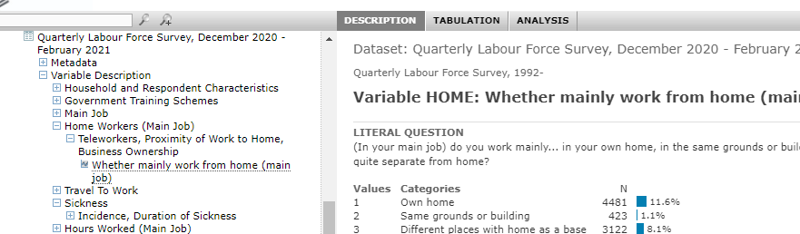
NESSTAR
Option to browse online
Simple analyses (tables, correlation)
Download data

Slide 17
What happens if you need Secure Access data?
Copyright © 2021 UK Data Service. Created by UK Data Archive, University of Essex

Slide 18
Legal gateway for access
Digital Economy Act (DEA, 2017)
Requires
Accredited Researchers
Accredited Projects
Accredited Processors
Notes:
Access to Secure Access datasets is through the Digital Economy Act, 2017 – DEA for short.
The Code of Practice under the Research Strand of the DEA requires both researchers and their projects to be accredited, and for the trusted research environment that they will access the data within, to be accredited as a processor. Researchers must be accredited before they can have access to their project.
The UK Data Archive was accredited as a processor by the Statistics Authority in 2020.

Slide 19
How to apply
Apply for Accredited Researcher(RS) status via ONS Research Accreditation Service (RAS)
Safe Researcher Training
AR number
Locate and request the data
Locate dataset in catalogue; add to project
Complete and submit application
Supporting information
Application reviewed
UKDS
ONS
Research Accreditation Panel (RAP)
Precedent process or RAP meeting
Notes:
Now we’ll walk through the application process. The process that will be described is for a researcher who is new to using our Secure Lab and is working alone and has never applied for ONS-owned data before.
Apply for AR status
The first step is to apply for Accredited Researcher (AR for short) status. AR applications are managed by the ONS Secure Research Service. Researchers must attend and pass Safe Researcher training before they can be awarded AR status. If you’re applying for access to LFS data in Secure Lab, we recommend that you book onto one of our Safe Researcher training courses, because we cover material specific to using the Secure Lab environment, but ONS will offer you the option within RAS to book onto one of their courses. If you attend training with ONS or another organisation that provides the Safe Researcher training, we will later ask you to complete some additional training to cover Secure Lab specific material. Once you’ve passed the training, ONS will send your AR number to you – keep a copy of this safe, as you will need to quote it on your project application.
2. Find and request access to the data
You will then need to locate the Secure Access LFS dataset(s) that you want to use via our online catalogue. As with the EUL, you will add it to a project. Then, once you’ve added the dataset to a project, you will be able to download the application documents. The project application form contains guidance on completing the form. You will also need to provide additional information part of the process relating to ethical approval, a Secure Access User Agreement, which needs to be countersigned by a legal representative from your institution, and your IP address and other technical information.
Application review
We then review your application, checking for feasibility and public benefit. This can involve some back and forth with you discussing the application, but once it’s passed our checks, we send it to the ONS for data owner approval.
Once the ONS return their approval decision, we then pass your application to the Statistics Authority’s Research Accreditation Panel (RAP for short), via their secretariat.
Once submitted to the RAP it might be reviewed through Precedent process, which means that they can be considered by a sub-group of the panel, rather than being sent for full panel scrutiny, In precedent cases, the turnaround is quite quick and a decision can be reached within a couple of weeks. Alternative, applications will be presented at the next full RAP meeting.

Slide 20
If RAP accredit project
UKDS check for any outstanding documentation and check your device
Set up SecureLab account and project
Notes:
We’ll be informed whether the project can be accredited or not.
Once we receive the accreditation decision, we check if we’re missing any documentation from you and our Technical Support team to finalise their checks and set-up a secure lab account and project.

Slide 21
Tips for a good application
Follow application guidance
Complete all sections fully
Submit all required documents
Make it clear and concise
Set out specific research questions/hypotheses
Address all feedback in one go
Notes:
Our access team who handle the applications have given the following tips for a good application
Follow the application guidance, if you’re unsure on any sections and need help, please contact our Helpdesk and we’ll be happy to support you.
Completing all sections on the form fully makes it is less likely we have to return your forms and ask for more information
You need to submit all the required documents for the application – it’s best to submit these in one go, rather than sending them piecemeal. But some can come at a later stage if you are delayed getting information from your institution.
Ensure that your content is clearly written and can be easily understood by someone who doesn’t know your specialist research area – this will make it easier for the people screening and scrutinising your application, and in turn help the process go quicker.
Under the DEA, projects must have a clearly defined scope. So set out specific research questions and hypotheses
If we have to ask you to make any changes, address all the feedback it one go, as having to review multiple times can slow down the process.

Slide 22
Remote access to SecureLab data
Data not downloadable, access remotely from organisational desktop (or UKDA Safe Room)
Access via web-based interface that uses secure encrypted Citrix Virtual Private Network technology
Outputs subject to Statistical Disclosure Control (SDC) process
Notes:
Now how does remote access to secure data work.
Secure data in not downloadable, instead you access it remotely from our organisation desktop or via the UK Data Archive Safe Room
Remote access is via a web-based interface that uses secure encrypted Citrix Virtual Private Network technology
Then, before you can get out any outputs, they are subject to Statistical Disclosure Control (SDC) process.

Slide 23
Available software in SecureLab
Stata
SPSS
R
SAS
Juputer Notebook
Qgis
ArcGis
Qtconsole
Spyder
Notepad++
MS Access
MS Excel
MS PowerPoint
MS WordMLwiN
Anaconda3 (inc. Python)
Acrobat Reader
Winzip
7zip
Explorer
Notes:
In the Secure Lab you get access to software, including all the main data analysis software and documents for working on outputs.

Slide 24
Importing and linking data - SecureLab
External data can be imported into the SecureLab project area
Permission is required from the Secure Access data owner and the external data owner
Notes:
You are able to import external data and link it to secure LFS data but you need approval of the secure access and external data owners.

Slide 25
Cite data
Citations on catalogue page
For multiple datasets, cite from the series page:
Office for National Statistics, Social Survey Division, Northern Ireland Statistics and Research Agency, Central Survey Unit. (2021). Quarterly Labour Force Survey, 1992-2020. [data collection]. UK Data Service. Series page: http://doi.org/10.5255/UKDA-SN-8738-2
Notes:
Finally ….something about citing the data….

Slide 26
Make sense of the documentation
Alle Bloom and Jen Buckley, UK Data Service, User Support and Training
Introduction to the Labour Force Survey and Annual Population Survey
Copyright © 2021 UK Data Service. Created by UK Data Service, University of Manchester
Notes:
In the session, we will looking at how make sense of and use of the wonderful documentation that comes with the LFS

Slide 27
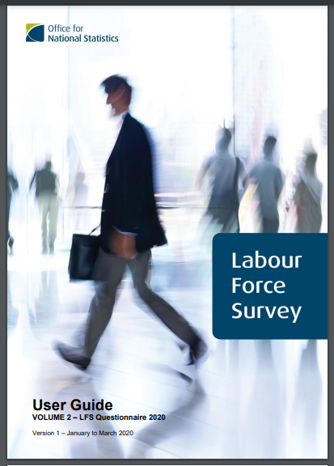
What?
11 Volume User Guide!
Plus
Additional data reports
Data dictionary
Notes:
Why do a session, just on the documentation? Because the LFS has some of the most extensive documentation for a survey I’ve come across. There is an amazing 11 volume user guide. There’s also additional reports and documents such as data dictionaries.
Blessing and curse. Takes a while to understand what’s where but actually if you come up against questions, there is usually information about it somewhere!

Slide 28
What for?
Study design, weights and different datasets
(Information from previous session)
Understanding variables
What’s asked when (waves and quarters)
What’s changed over time
Derived variables
Which variables are in which datasets
Notes:
The documentation provides detail about the study design, weights and the different datasets (which Martina and Simon went through earlier).
There is also a lot of information about how to understand the variables in the dataset such as
Which questions are asked when
What’s changed over time
How variables have been derived
And which variables are in which datasets.
How to use the documentation to find out about variables is what we’ll focus on in this session.

Slide 29
Where is the documentation?
Catalogue records
Data downloads
Use Guide on ONS website (google LFS user guide)
Notes:
So first question, where is the documentation.
You can actually access it in a number of places.
On the catalogue page you can access all the documentation for a particular dataset.
You also get it when you download the data.
You can get the user guide on the ONS website – which comes up better in a search engine.

Slide 30
LFS user guide
LFS User Guide Vol. 2 - Questionnaire 2020
LFS User Guide Vol. 3 - Details of LFS Variables 2020
LFS User Guide Vol. 4 - Standard Derived Variables 2016
Notes:
When is comes to look at information about variables – there are 4 main documents.
We have the questionnaire where you can see full question and routing.
Volume with details of all variables including derived variables.
A detailing how derived variables have been derived

Slide 31
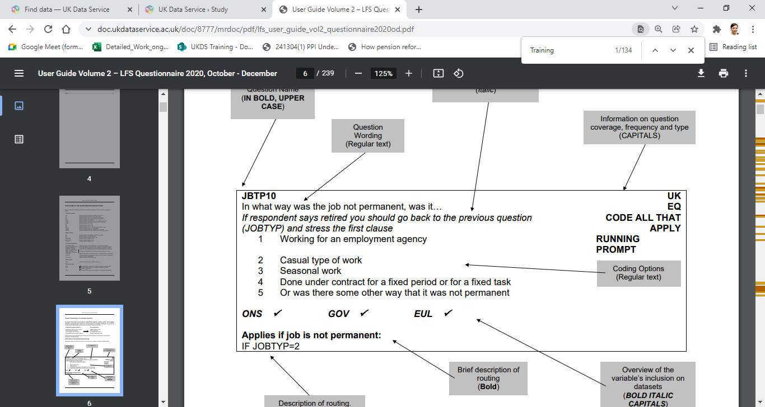
Volume 2: Questionnaire
Notes:
So looking at Volume 2 – the questionnaire. You’ll find details for each question in the survey. There is the full question wording and the possible responses. There is also lots of other information such as how often the question is included, any questionnaire routing and details about the datasets where the resulting variable can be found.
At the beginning of the document, there is guide to deciphering all the information that is provided, so when using the documentation, it can be goods to have a look at this first.

Slide 32
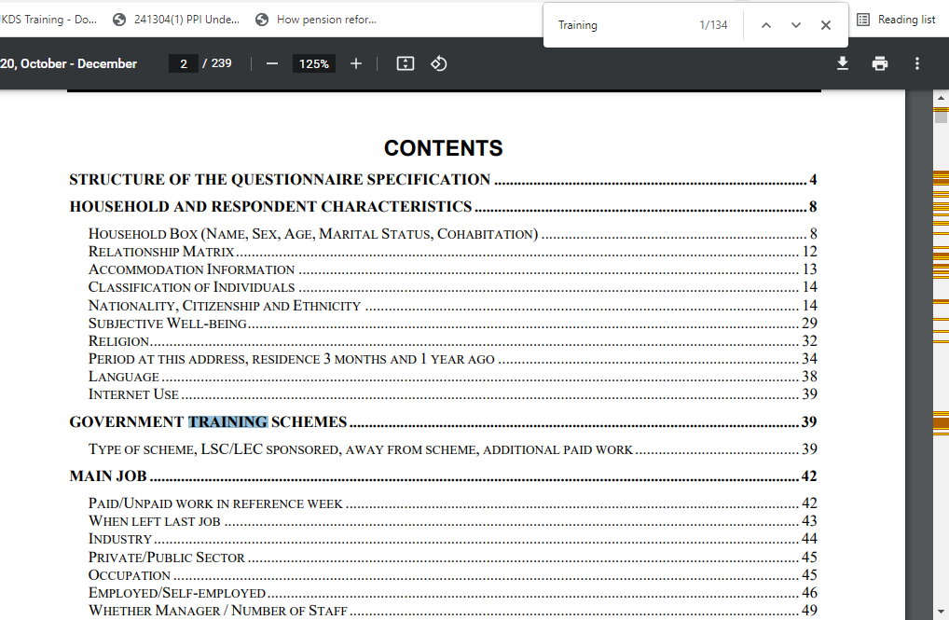
Volume 2 – contents page
Notes:
At the front, there is a contents - which gives useful insight into the ordering of questions in the survey and can help you find the questions relevant to you.
You can also search using cntrl+F. How useful a search is depends on what you’re searching for as you’ll find some terms appear frequently when we search through all the questions (including all the response options). For example, the term training can be found 134 times. Some of the mentions will relate to people being current in education or training and some about workplace training. So it can take a bit of work to find where you want to go. But if interested in say participant Government training schemes, the contents page tells you there is a section on this.

Slide 33
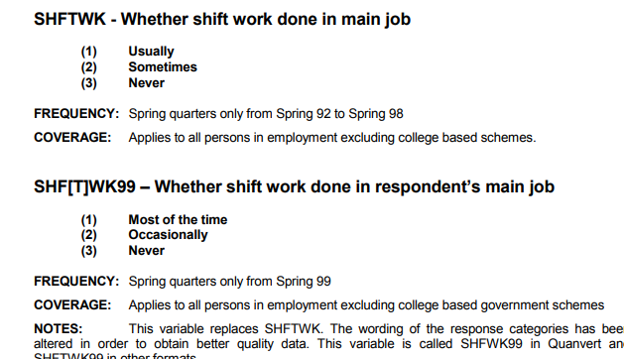
Volume 3: Variable details
Includes derived variables
Includes information about change over time
Notes:
Next, Volume 3 – this offers information about all the variables. Different to the questionnaire as it includes derived variables and information about change over time, so when questions were introduced and what they replaced etc.
The details about frequency, coverage read the notes are really useful in understand whether you’ll find the variable and what it does and doesn't capture.
So for example, there is a variable called SHIFTWK that was included in the spring quarter between 92 and 98 – which applied to all those in employment. This was then replaced by SHFWK99, following an updated to the question wording.

Slide 34
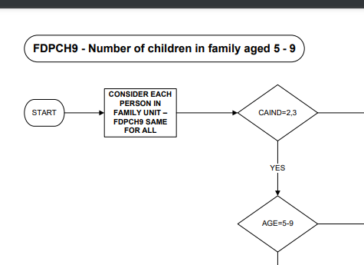
Volume 4: Details of derived variables
Flow charts detailing how variables are derived
Notes:
Volume 4 includes details how derived variables. For each derived variable, you will find a flow chart showing how it had been derived.

Slide 35
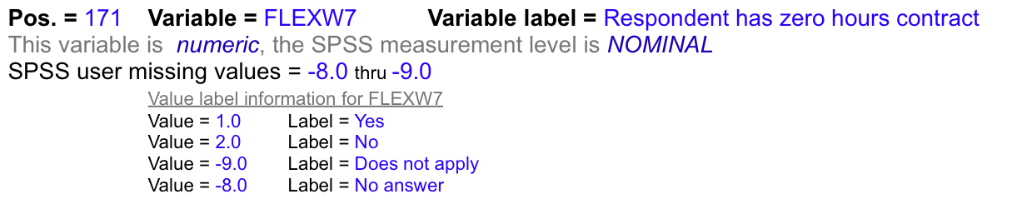
Data dictionaries
From UK Data Service for each dataset
Check if variables are included before downloading
Useful if not clear from the documentation
Especially, useful for
Annual Population Survey
2 and 5 quarter files
Notes:
The UK Data Service also produces data dictionaries, which detail all the variables present in a particular dataset. These are very useful for checking if variables are actually in the dataset – as it’s not always 100 percent clear whether a variable has been removed from an EUL dataset, or are included in a quarter. They are also very useful for the longitudinal files and the APS, where it is not always clear in the documentation.
Switch to Jen

Slide 36
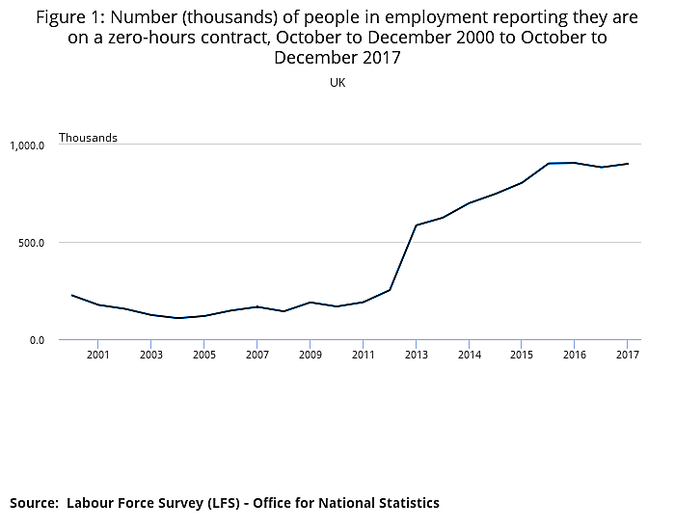
Practical exercise: Research on zero-hour contracts
Explore variables relating to zero-hours contracts
Use documentation
Step by step instructions in handout
Additional:
questions about whether certain analyses are possible
Notes:
Switch to Jen
Ok, we’ve now got a practical activity for you. The activity has been designed to help you get familiar with how to use the documentation to find out about variables in the data.
We will be exploring what variables are available to examine zero-hour contracts – so looking at which variables you can use, what’s the differences between the different variables and when are they available? So questions you can answer just looking at the documentation.
We’ve got step by step instructions with pointers of what to look for.
There’s also some additional questions about whether certain research questions are possible to examine using the data that’s available. But there’s a good chance you won’t get to these in the time available.
There are also answers available to check when you want. Feel free to ask questions as you go in the chat or turning microphone on. We’ll spend about 15 minutes and then have a recap at the end.
RECAP
OK – as we come to the end, I have a short set of questions. Look and see what you think: https://forms.office.com/Pages/ResponsePage.aspx?id=B8tSwU5hu0qBivA1z6kad7z1WpCLo_xNrnysawBILOJUMjA5OVFSRE0zN0dLMjlYVldONFJVNUJIVC4u
The survey contains a question labelled FLEX10 – that asks about flexible working. Respondents can give up to three responses. First, second and third responses are contained in different variables, which have the suffixes 1, 2, or 3. So Flex101 is a variable that records first responses.
FLEXW7 and FLED10 will not always five the same number of people on zero-hour contracts.
FLEXW7 comes from answers to FLEX10. It is a dichotomous variable (yes, no) indicating all mentions of whether a person has a zero-hour contract.
Fled10 records the main type of work arrangement. It has 10 categories with zero-hour contracts being 1. The numbers having zero-hour contract as their main work arrangement can be less than all those mentioning a zero-hour contract.
Can you examine differences across local authorities using the EUL data?
No – that’s right. There is a variable for local authority, but this is only in the APS. To see, if the research is possible with the APS, you would then need to see if information about zero-hours contracts is held in the APS.

Slide 37
Explore the data
Jen Buckley, UK Data Service, User Support and Training
Introduction to the Labour Force Survey and Annual Population Survey
Copyright © 2021 UK Data Service. Created by UK Data Service, University of Manchester
Notes:
Now, we are going to look at exploring the data with some practical exercises.

Slide 38
Quarterly Labour Force Survey, October - December, 2020
Recreate ONS estimates
EMP07 Temporary Employees
EARN04: Gross weekly earnings of full-time employees
Aim: get familiar with the data
Format: Code/syntax file + review questions (and answers)
Notes:
We’re going to start off with the Quarterly Labour Force Survey – using the one from Oct-December last year.
In each practical, the overall aim is to use the data to recreate some ONS estimates. So in the first practical, we’re going to produce some
estimates of temporary employees.
Then in the second, exercise were going to look at estimates for gross-weekly earnings of full-time employees.
Though the overall task is to make the estimates, the aim here is really to get familiar with the data. So just take your time as you go through asking questions about anything your not sure of.
The format of the exercises, is that there are prewritten syntax or code files for the analyses. So let’s have a look at these.
There are set of files for each different software (so I’ll look at the ones for SPSS). A file for each practical.
[open first one]
So the first task is to open the data. [the Stata and R code include code for reading in the right file]
It’s then a good idea to save the file with a new name and work with the new version – so you have the original to fall back on if it goes wrong.
Through the file, you then have a mix of commands and review questions. Some of the questions will be pretty obvious and others less so, but they are there to help you check you know what’s going on. There is an answer sheet here.
So the files came to use in SPS syntax and we’ve created Stata and R versions. They similar enough that you get something equivlant out of it, but there will be some differences.

Slide 39
Breakout rooms
You can use the chat for your group
Ask us questions
Take a 5 minute break when you want
Back in main meeting at 2.20

Slide 40
Recap
Grossing weight
Using filter to select relevant population
Income weight for analyse of income
Estimates for number of fulltime employees varies of using income weight (so be careful)
Notes:
Recap
First exercises – weight in the LFS is a grossing weight (which means it’s aims to known population totals), so when we use it the frequencies are much higher when the weight is applied.
We then use a filter to select those in non-permanent employment.
What we also see, is that though we have a large sample to start of with so over 74 thousand people, by the time we get to looking at temporary employees we have around 1, 600.
The second exercises that looks at earnings. We need to use a different weight when looking at income.
We then select through of interest and create the table.
What should be noted is that estimates for things like the number of fulltime employees varies depending on whether we use the standard weight or the income weight. So we need to be really on top of what weight we should be using.

Slide 41
Explore the data 2
Continue Practical 1 and Practical 2
Also Practical 3: Examining Labour Market Flows
Labour market flows NSA: sheet in dataset X02
Two-Quarter Longitudinal Dataset, July - December, 2020
Until 2.20
Notes:
For the rest of session. You can continue with practicals 1 and 2, which use a quarterly file
There is also a practical 3 that uses a 2-quarter longitudinal file.
Again the aim is to get familiar with the data and in this practical, you can explore different ways of looking at labour market flows.

